Slide 1


Computer Science in Modern Biology Introduction to .
Instructor:
Rachel Pilla
TAs:
Andrew Cannizzarro
Nicole Berry

Slide 2
Workshop Schedule
Day 1 (Monday):
Introduction to R
Coding basics
Working with data in R
Troubleshooting R scripts
Day 2 (Tuesday):
Formatting and manipulating data
Basic analyses and plotting
Practice group exercises

Slide 3
Workshop Logistics
Zoom
Feel free to unmute yourself to ask questions at any point
Chat
Post any questions or comments here
The TAs will be checking the chat to help answer questions
Break-Out Rooms
If you are really stuck, you can move to a break-out room with a TA to share your screen and get you up to speed
Break time is a great opportunity for this if needed!

Slide 4
What is R?
FREE and OPEN SOURCE statistical and computational program
Simple Google searches can give you effective solutions to questions and troubleshooting issues in R
Widely used in sciences and rapidly growing in popularity
Can handle more advanced computations, statistical analyses, and bigger data files than Excel
Lots of styles to code and get the exact same output or result

Slide 5
Introduction & Basics in R

Slide 6
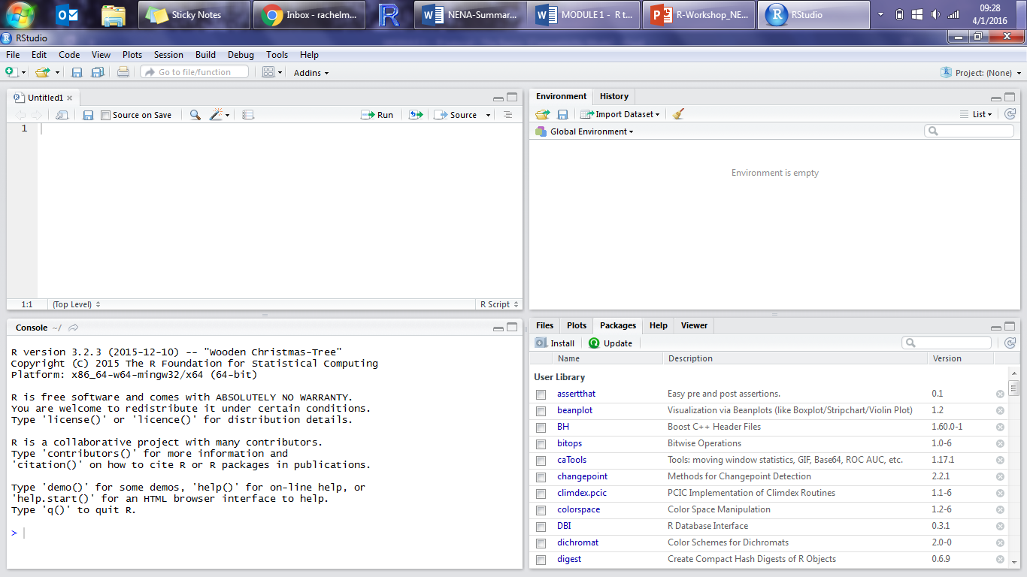
R script
R script:
This is where you write and edit your code and comments
RStudio color codes your scripts to make it easier to identify names of functions, numbers, and comments
It also automatically fills in parentheses & quotations

Slide 7
R script
R console
R console:
This is where your commands are run, and where results appear
The “>” symbol in blue means R is ready to work.
If you see a “+” after running code, then something did not finish running, and/or you have an error or forgot a parenthesis

Slide 8
R script
Environment
R console
Environment:
This is where you can see which objects you have created
It also tells you what type of object it is, and it’s size and dimensions

Slide 9
R script
Environment
Plots, Packages, & Help
R console
Plots/Packages/Help:
This is where your plots will appear
You can also see what packages are installed and available
Most importantly, this is where you find help files that tell you how to use functions/arguments

Slide 10
Packages in R
Packages are bundles of tools and functions that others have developed to be used in R
They are often grouped to specific types of functions, analyses, or datasets
rLakeAnalyzer, for example, has lots of functions developed by limnologists to help you analyze common types of data collected from lakes

Slide 11
Packages in R
Currently, there are over 16,000 packages!
We are going to install 2 packages to use today:
dplyr
tidyr

Slide 12
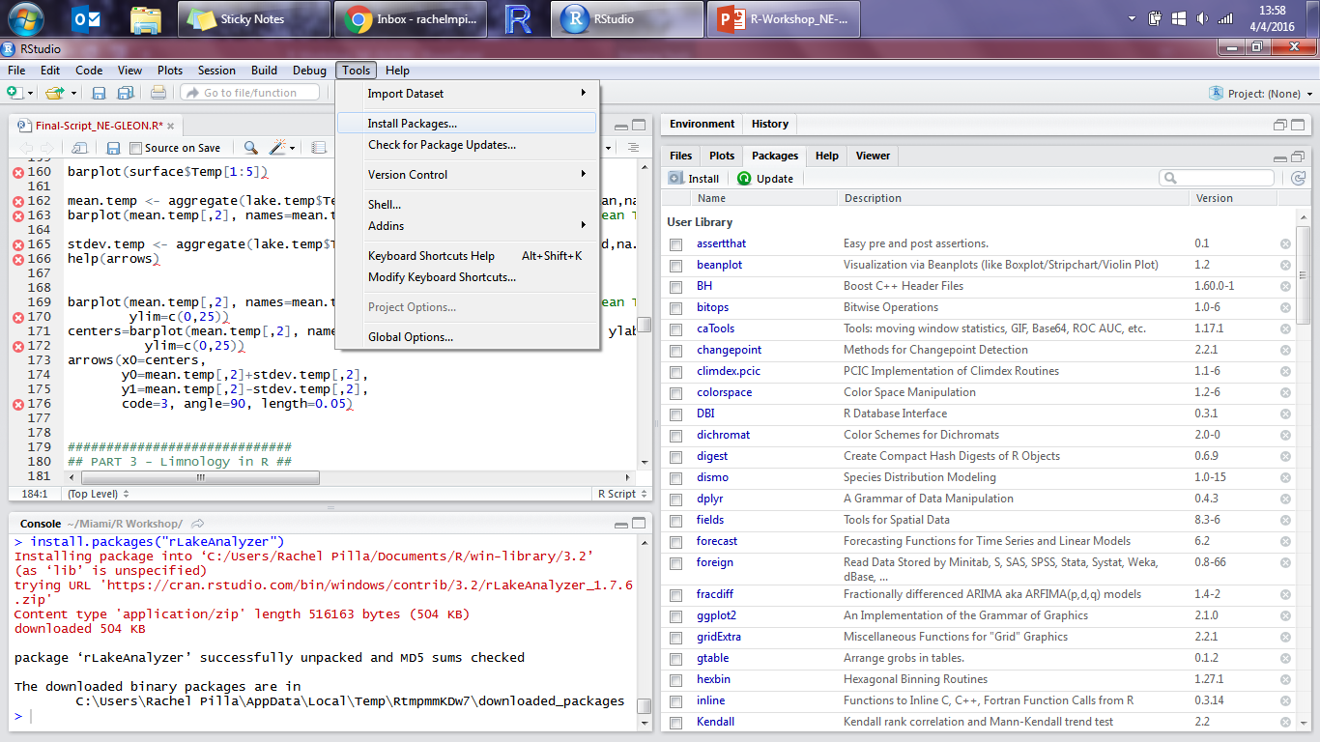
Installing a Package
Tools → Install Packages…

Slide 13
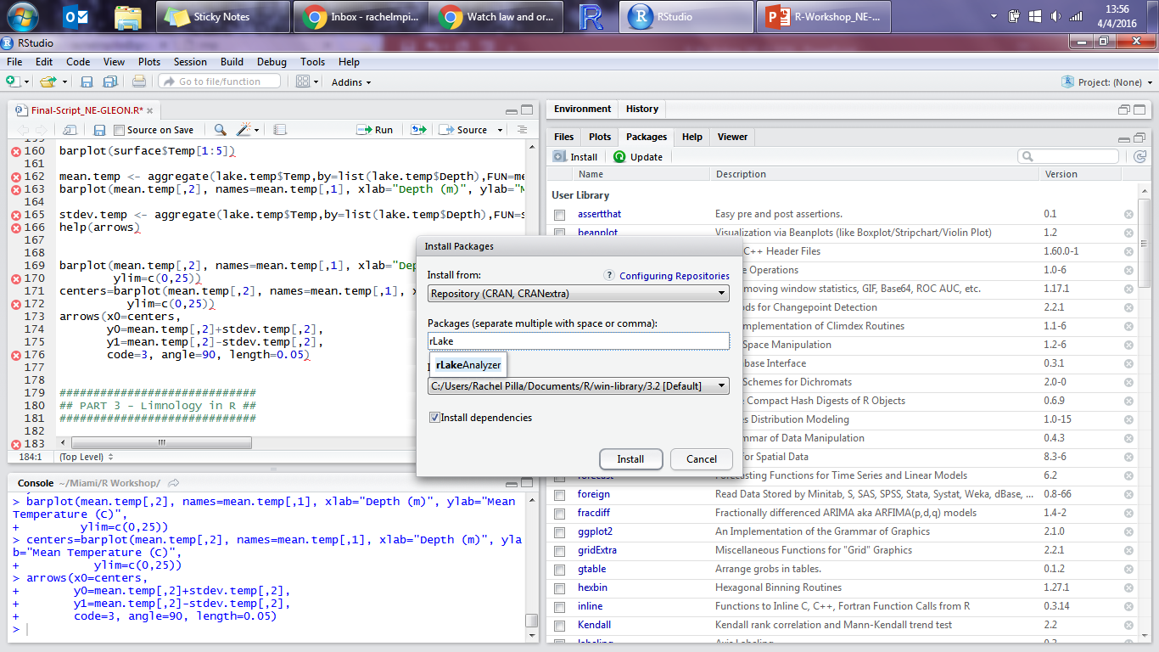
Installing a Package
Type the packages you want to install: dpylr, tidyr

Slide 14
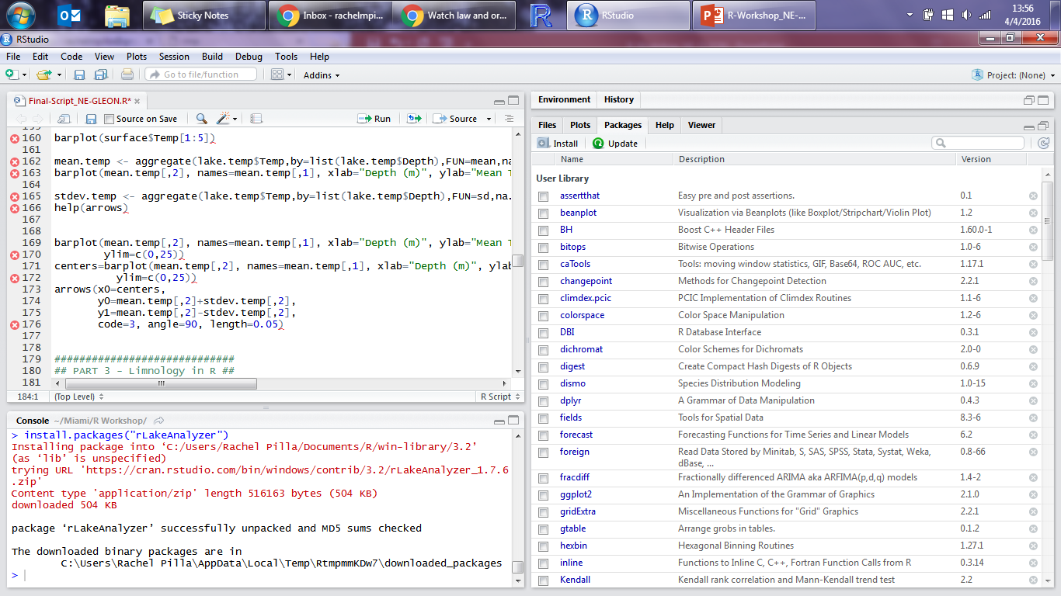
Installing a Package
Console will tell you when they have been installed

Slide 15
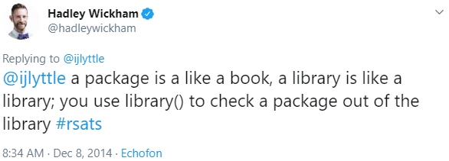
Installing a Package
Packages only need to be installed ONCE
But, each time you re-open R, you need to load the package(s) you want to use so R can make all the functions available:
library(package name)

Slide 16
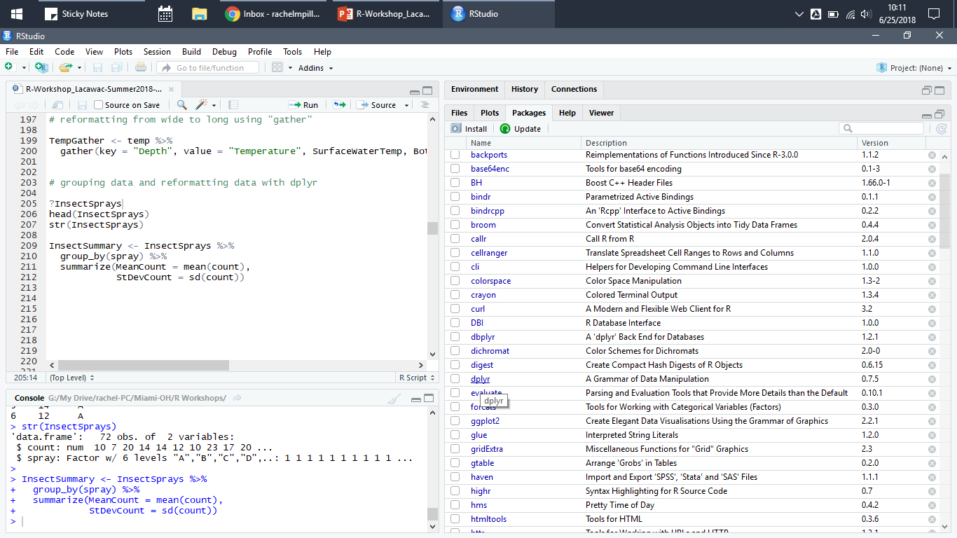
Package Information
Under the “Packages” tab, click on dplyr

Slide 17
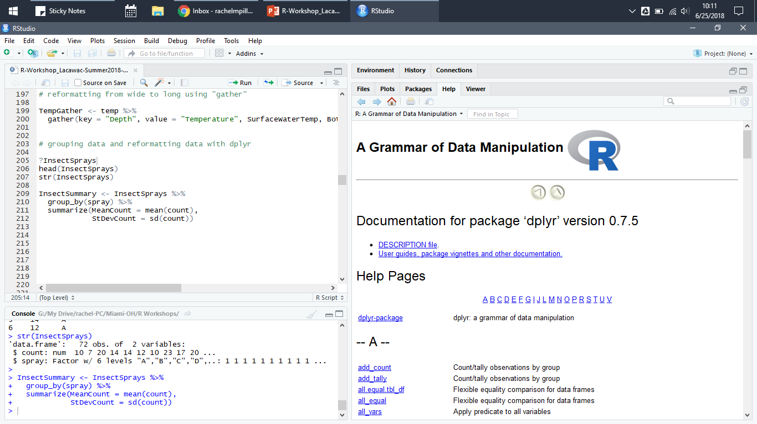
Package Information
This will list all the available functions
Clicking on a function takes you to the help file

Slide 18
Using an R Script
Write commands in the script (top left pane)
Save it, edit it, revisit it later, etc.
Code NOT automatically run when you hit Enter
To run code:
“Run” button in upper right corner of R Script
“CTRL + Enter” shortcut on PC
“Command + Return” shortcut on Mac

Slide 19
Using an R Script
Add in comments using “#”
Comments can be any information in an R script that will NOT be run, but can be used for notes/explanations/etc.
Anything behind “#” will be ignored by R
R is case sensitive
“Mean” ≠ “mean”
R doesn’t care too much about spaces (or lack thereof)

Slide 20
Using an R Script
Be careful to close all parentheses & quotations (and in the correct spots!)
A majority of your errors will come from missing or misplaced parentheses or quotations – but they’re usually easy fixes!
“>” at the beginning of Console means it’s ready to go!
“+” means code is still running or it is not complete
Often missing parenthesis, bracket, or quotation

Slide 21
Key Components of Code
Functions allow you to manipulate data, apply calculations, run statistical analysis, and more
Arguments are the defining information for functions, and allow you to “customize” the function to have it do what you want it to do
Objects are pieces of data saved in R that can be called up, reused, or manipulated

Slide 22
Key Components of Code
x <- seq(1,10)
name of the function to create a sequence

Slide 23
Key Components of Code
x <- seq(1,10)
the arguments to define the function, to create a sequence from 1 through 10

Slide 24
Key Components of Code
x <- seq(1,10)
name of the object that saves the results of the function in R

Slide 25
Key Components of Code
x <- seq(1,10)
names of objects must begin with a letter, but can include uppercase or lowercase letters, numbers, underscores, and periods – make your object names clear and useful!

Slide 26
Key Components of Code
x <- seq(1,10)
assignment operator tells R to save the result of the function as the named object

Slide 27
Types of Data
An object can hold data that is:
Numeric
Integer
Characters (strings)
Logical (TRUE/FALSE)
Complex (1+4i)

Slide 28
Types of Data Structures
An object can be in the form of:
Vector
1-D object with the same data type
Matrix
2-D object with the same data type
Data frame
2-D object with different data types for each column if desired
Generally the most useful for biological and ecological data

Slide 29
Live Coding
open RStudio and code along!

Slide 30
Computer Science in Modern Biology Introduction to .
Instructor:
Rachel Pilla
TAs:
Andrew Cannizzarro
Nicole Berry

Slide 31
Review of Day 1

Slide 32
Workshop Logistics
Zoom
Feel free to unmute yourself to ask questions at any point
Chat
Post any questions or comments here
The TAs will be checking the chat to help answer questions
Break-Out Rooms
If you are really stuck, you can move to a break-out room with a TA to share your screen and get you up to speed
Break time is a great opportunity for this if needed!

Slide 33
Layout of RStudio
R script
Environment
Plots, Packages, & Help
R console

Slide 34
Packages
Packages only need to be installed ONCE
But, each time you re-open R (today!), you need to load the packages you want to use so R can make all the functions available:
library(package name)

Slide 35
Using an R Script
To run code:
“Run” button in upper right corner of R Script
“CTRL + Enter” shortcut on PC
“Command + Return” shortcut on Mac
“>” at the beginning of Console means it’s ready to go!
“+” means code is still running or it is not complete
Often missing parenthesis, bracket, or quotation

Slide 36
Key Components of Code
Functions allow you to manipulate data, apply calculations, run statistical analysis, and more
Arguments are the defining information for functions, and allow you to “customize” the function to have it do what you want it to do
Objects are pieces of data saved in R that can be called up, reused, or manipulated

Slide 37
Types of Data
An object can hold data that is:
Numeric
Integer
Characters (strings)
Logical (TRUE/FALSE)
Complex (1+4i)

Slide 38
Types of Data Structures
An object can be in the form of:
Vector
1-D object with the same data type
Matrix
2-D object with the same data type
Data frame
2-D object with different data types for each column if desired
Generally the most useful for biological and ecological data

Slide 39
Live Coding
open RStudio and code along!

Slide 40
Additional Tips & Useful Resources

Slide 41
“NA” Values
R recognizes “NA” or blank cells from Excel as missing values
If you have another format for indicating “NA” values, you can add an argument when importing your data file:
read.csv( … , na.strings = “n/a”)
Many functions will automatically ignore/skip over “NA” values
Be sure you read the associated help files to ensure the function is treating “NA” values as you are expecting, or adjust the argument accordingly!

Slide 42
Assorted Useful Functions
ncol(…)
nrow(…)
colnames(…)
rownames(…)
length(…)
dim(…)
unique(…)
paste(…)
sort(…)
order(…)
t(…)
cbind(…)
rbind(…)
rep(…)
seq(…)
range(…)
sum(…)
sd(…)
var(…)
diff(…)
round(…)
ifelse(…)

Slide 43
Swirl
Package for self-guided learning of R in the R environment
Learn at your own pace and select topics most useful to you
Introductory material
Regressions
Data wrangling
Statistical inference
Advanced programming
https://swirlstats.com/

Slide 44
RStudio Cheat Sheets
Short, handy guides to help with many packages and programming needs in RStudio
Available free for download in multiple language options
https://rstudio.com/resources/cheatsheets/

Slide 45
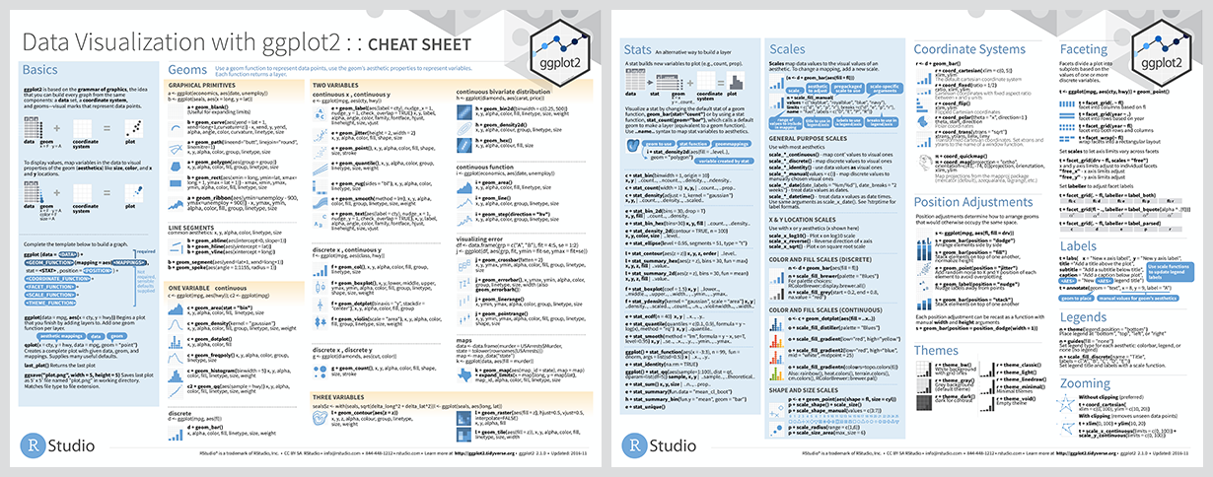
ggplot2 Cheat Sheet

Slide 46
ggplot2 Cheat Sheet

Slide 47
Tidyverse
Packages to help organize data and streamline R coding, specifically for data science
Functions in the packages share similar syntax and coding structure
“dplyr”, “tidyr”, and “ggplot2” are part of tidyverse
https://www.tidyverse.org/

Slide 48
Lubridate
Package for more effectively working with dates between Excel and R
Can recognize date/times with minimal formatting issues
Also allows for date/time differencing, among other useful functions
Included in tidyverse
https://lubridate.tidyverse.org/

Slide 49
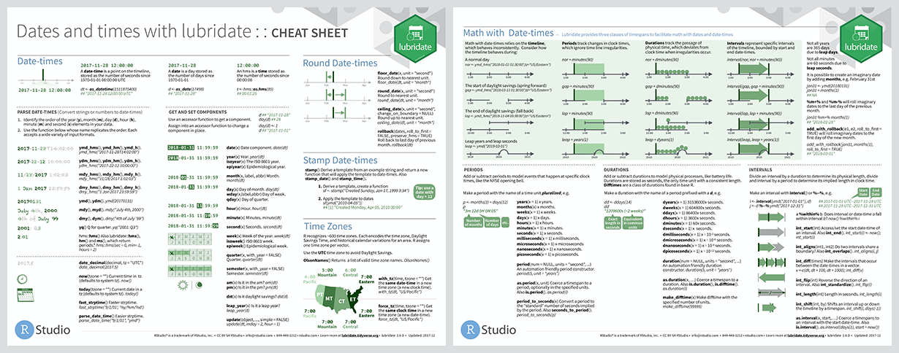
Lubridate

Slide 50
Lubridate

Slide 51
ColorBrewer
Pre-made color schemes and palettes
Effective graphic color selections for maximum perception
Qualitative, sequential, and diverging
Includes options for photo-copy friendly, color-blind friendly, etc.
http://colorbrewer2.org/

Slide 52
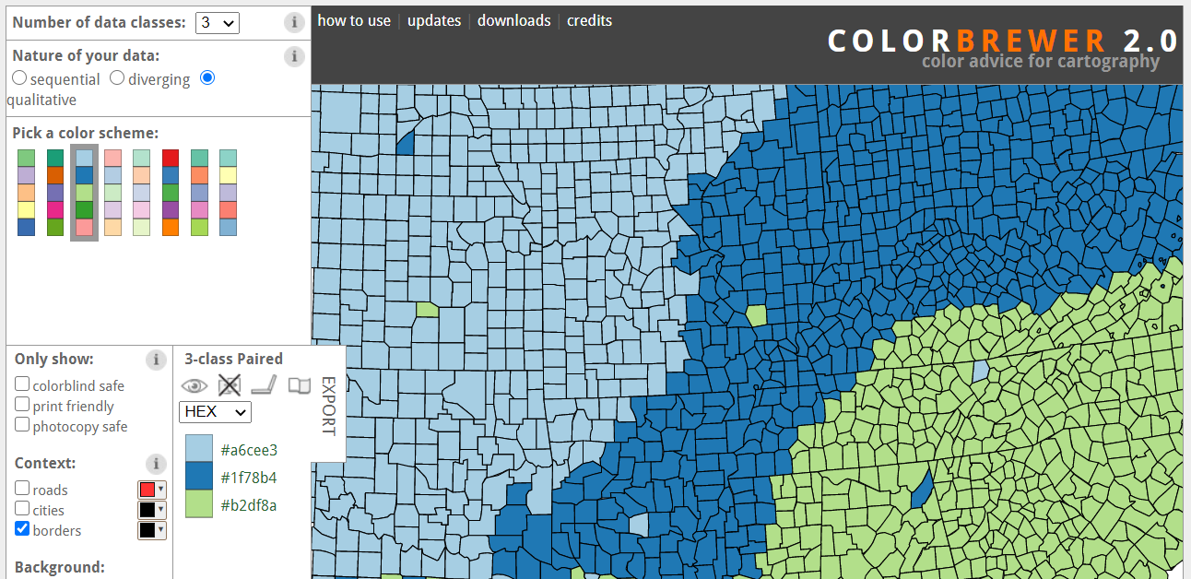
ColorBrewer

Slide 53


Computer Science in Modern Biology Thank you for joining!
to share feedback or ask questions, please feel free to contact me: pillarm@miamioh.edu
@rmpilla

